Slide 1
Not-Petya
IST-623
Joshua Colburn | Eric Brattin
John Christman | Niki Bawa

Slide 2
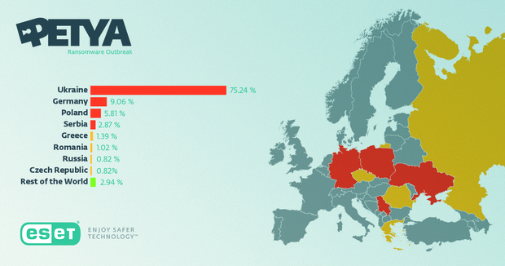
Context: Who, What, and Where?
WHO: Russian military hackers attacking Ukraine, with the malware spreading across Europe, Asia, and the Americas.
Elite hacking team within the GRU’s Unit 74455 known as Sandworm.
Same group indicted by the DOJ for involvement in the DNC hack of 2016**.
WHAT: Not-Petya malware, based on code stolen from the NSA (Eternal Blue) and a flaw in MS code exploited by Mimikatz appeared to be ransomware that actually permanently wiped data.
WHERE: Ukraine to begin with, but spread across the world.
(% of infected computers.)
Notes:
**Experts at CrowdStrike believe there is overlap of team known as FancyBear (DNC) and Sandstrom (NotPetya) GRU hacking teams.

Slide 3
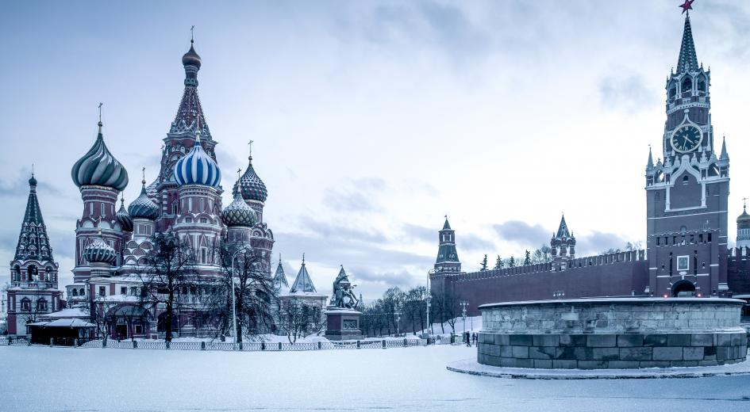
THE GRU (G.U) AND INFORMATION WARFARE
Notes:
Main Directorate of the General Staff of the Armed Forces of the Russian Federation (GRU) is Russia's main military intelligence agency tasked by the Russian state to leverage "active measures" such as hacking against civilian or military targets, as a means to disrupt, discredit, and cause disarray, according to the FBI.
Sabotage, disception, propaganda, "myth building"

Slide 4
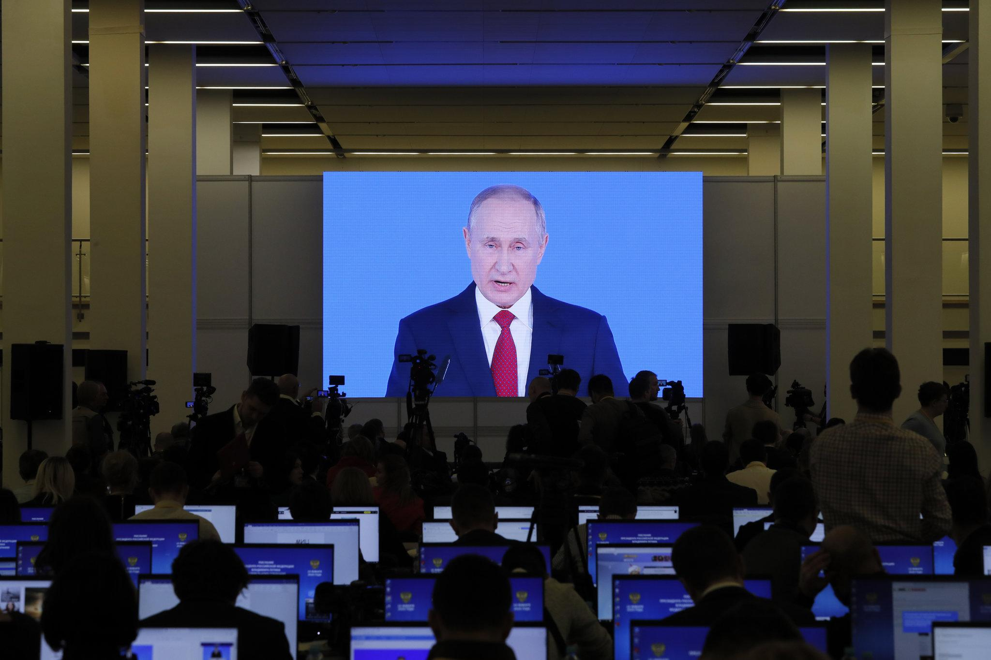
"I can’t think of another group that can claim to have not only tried so many brazen acts, but actually pulled them off."
"These guys are really about the impact. They’re about sabotage and disruption."
“Russian hackers, as sophisticated as they are, also tend to be lazy. They use what works. And in this, they were successful.”
Notes:
Russian hackers, as much as they want to be, are not the James Bond villians they pretend to be. They almost always leave digital fingerptints and recycle malware and code that works

Slide 5
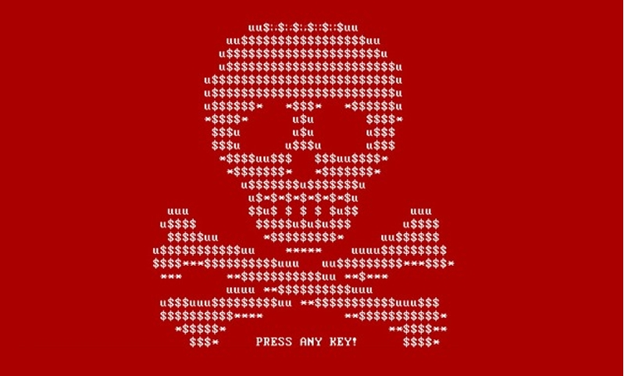
Context: Why, When, and How?
WHY: Russia’s long-standing political grievances with Ukraine, and, according to British Intelligence, an intent to destabilize the world.
For more than 4 years prior to the attack Ukraine had been in a...
“grinding, undeclared war with Russia..(which has) seen Ukraine become a scorched-earth testing ground for Russian cyberwar tactics.”
WHEN: June 2017
HOW: “Watering hole” attack targeting a Ukrainian site that delivered updates for tax and accounting software programs known as M.E.Doc, an Ukrainian equivalent of TurboTax or Quicken, according to Wired.

Slide 6
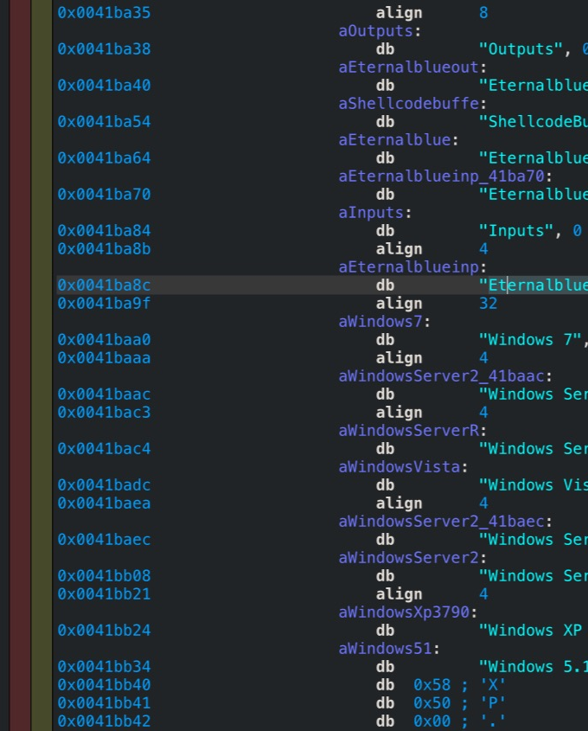
Issues in Context: The Malware
Precursors to Not-Petya:
Petya: ransomware targeting Windows systems which “infected the master boot record to execute payload that encrypts a hard drive’s file system table and prevents Windows from booting.” Used to extort money from victims to unlock files.
EternalBlue: Once infected, allows ransomware to gain access to other machines on the network.
MimiKatz: Flaw in Windows that left users’ passwords in memory
Notes:
EternalBlue allows remote code execution. Should have been patched.
MimiKatz can’t be patched but it can only dump credentials and passwords if executed as local administrator. STILL NOT PATCHED, just mitigated around it.

Slide 7
Issues in Context:
What problems were introduced?
Leverages previous malware contained in Petya, along with Mimikatz, a hacking tool used to steal passwords and EnternalBlue, a NSA-created exploit, all used to infect the master boot, encrypt the hard drive, and then spread to other machines on network.
Root cause of the issue:
Weakest Link Failure (Maersk)
Notes:
****EternalBlue is based on Common Vulnerabilities and Exposures or CVE 2017-0144, which is rated 8.1/10 on Common Vulnerability Scoring System Calculator highlighting its critical degree of of vulnerability
*** As outlined by the Department of Commerce, EternalBlue "allows remote attackers to execute arbitrary code via crafted packets, aka "Windows SMB Remote Code Execution Vulnerability."

Slide 8

Issues in Context:
What Were The Policy Issues?
No buy in to Corporate cyber strategy
Lack of an effective Patching policy
Lack of Proper software vetting
Ability to transfer from low to high security zones
Ineffective scanning for vulnerabilities
Notes:
Maersk failed to promote security as an enabler to their corporate success and as a result, requested policy changes were never implemented. Their organizational policies should have set the standard for the approach to overall security
They had installed the vulnerable software on just one of their thousands of computers. It was through this access point that their entire network was attacked.
1 server offline -Indirectly, this demonstrates the benefits of network segmentation, an important component of defense in depth.
issue specific policies could have prevented the installation of the M.E.Doc application.
patching requirements would have ensured the Eternal Blue patch was installed which would have prevented the attack from progressing farther than the single PC. Eternal Blue patch was distributed 4 months earlier
System specific policies should have dictated back-up procedures for the domain controllers including off-line backups as well and network segmentation for critical systems.
Lack of segmentation also prevented the implementation of security models that should have prevented low to high data transfers.

Slide 9
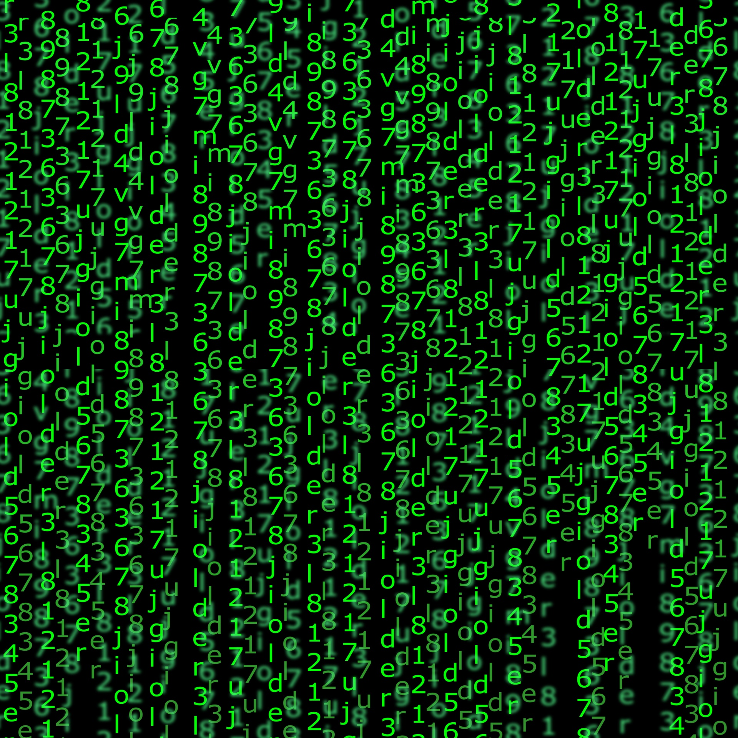
Challenges:
The Encryption
Used as a weapon, not prevention.
Physical Drive Manipulation:
XOR encryption:
File Encryption:
AES 128 and RSA 2048
MFT Encryption:
Salsa20
Notes:
Physical drive manipulation – The master boot record which stores critical details regarding the OS was encrypted using XOR
File encryption – encrypts common file extensions with an AES-128 key. That key is encrypted with RSA-2048 key. RSA-2048 key is then destroyed. Breaking this key would take 6.4 quadrillion years. 6.4^15
MFT Encryption – 16 byte encryption key generated to use Salsa20 encryption. 8 byte nonce.
The buffer containing the encryption key is overwritten to destroy the key
Encrypts the Master File table – this is the directory containing the links to every file and table
*Salsa20 is a stream cipher. 20 rounds in groups of 4. Add-rotate-xor. Best attack has only broken 8 of the rounds. The nonce is a one time use authentication to avoid replay attacks.
Were used to cripple the infected systems.
Credential theft was part of the attack which bypassed any potential encryption by becoming a trusted node.

Slide 10
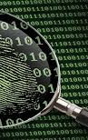
Challenges:
Challenges that emerged:
Rapid spread of code around the world.
Perspectives of various actors:
Oleksii Yasinsky.
Maersk
Decisions Taken:
Shut down systems.
Actions or Changes Made:
24/7 operation to re-establish worldwide systems.
Notes:
Challenges that emerged.
The code that the hackers pushed out was honed to spread automatically, rapidly and indiscriminately: “To date, it was simply the fastest propagating piece of malware we’ve even seen.” says Craig Williams, director of outreach at Cisco’s Talos division.
Within hours the of its first appearance, the worm raced beyond Ukraine and out to countless machines around the world, from hospitals in Pennsylvania to a chocolate factory in Tasmania.
Perspectives of various actors:
Oleksii Yasinsky. Head of cyber lab at Information Systems Security Partners, a company that is the go-to firm for victims of Ukraine’s cyberwar.
Saw NotPetya attack on Oschedbank’s system (second largest bank in Ukraine).
Heard other companies and government agencies also under attack.
Witnessed the rapid destribution of Ukraine’s computer systems that were under NotPetya attacks.
Maersk. M.E.Doc, a Ukrainian version of Turbotax, was installed on a single computer in Maersk’s office in Odessa that led to the widespread infection of NotPetya on Maersk’s computers.
Maersk customer: “It was clear this problem was of a magnitude never seen before in global transport. In the history of shipping IT, no one has every gone through such a monumental crisis.”
Decisions taken:
Maersk. IT department shut down the entire system. Hired the consulting firm Deloitte with unlimited funds to solve the problem.
Actions or changes made:
Maersk’s office in Maidenhead, England had become a 24/7 emergency operations center with the singular purpose to rebuild Maersk’s global network in the wake of its NotPetya meltdown.
Noone could find a backup of Maersk’s domain controllers, the servers that function as a detailed map of Maersk’s network and set the basic rules that determiene which users are allowed access to which systems. Finally found one domain controller in a remote office in Ghana that had been knocked out prior to the NotPetya attack because of a blackout. Had someone physically bring several hundred gigabyte domain controller backup to UK via Nigeria as they could not get a visa for their Ghana employee.
Problem was solved two weeks later after orders were taken and shipped in an ad-hoc manner, such as using Whatsapp.

Slide 11
Challenges: Anti-Forensics
How Not-Petya Hid Itself:
Deletes records of itself from disk
Clears all of the file contents from disk
Uses Command line to clear logs from setup, system, security, application, and the USN journal.
Demands $300 in Bitcoin to “unscramble the hostage data” even though the mechanisms to collect money from victims didn’t exist.
“little effort or thought put into pocketing the loot”

Slide 12

Outcomes:
Estimated $10 Billion Dollars in damages
How Maersk avoided total loss:
the key to Maersk’s recovery was a server that, by pure chance, happened to be offline at the time of the attack. Indirectly, this demonstrates the benefits of network segmentation, an important component of defense in depth.
"Just weeks after WannaCry crippled the NHS and broader industries, NotPetya hit...One year on from NotPetya, it seems lessons still haven't been learned.”

Slide 13
References:
Banerjea, A. (2018, August 27). NotPetya: How a Russian malware created the world's worst cyberattack ever. Retrieved from https://www.business-standard.com/article/technology/notpetya-how-a-russian-malware-created-the-world-s-worst-cyberattack-ever-118082700261_1.html
Greenberg, A. (2018, December 7). The Untold Story of NotPetya, the Most Devastating Cyberattack in History. Retrieved from https://www.wired.com/story/notpetya-cyberattack-ukraine-russia-code-crashed-the-world/
Greenberg, A. (2019, November 15). The Evidence That Links Russia's Most Brazen Hacking Efforts. Retrieved from https://www.wired.com/story/sandworm-russia-cyberattack-links/
Muncaster, P. (2018, October 4). NCSC: Russia's GRU to Blame for DNC and Other Attacks. Retrieved from https://www.infosecurity-magazine.com/news/ncsc-russias-gru-blame-dnc-other/
Nakashima, E. (2018, January 12). Russian military was behind 'NotPetya' cyberattack in Ukraine, CIA concludes. Retrieved from https://www.washingtonpost.com/world/national-security/russian-military-was-behind-notpetya-cyberattack-in-ukraine-cia-concludes/2018/01/12/048d8506-f7ca-11e7-b34a-b85626af34ef_story.html

Slide 14
References: Continued
Schouwenberg, R. (2019, August 26). NotPetya Ushered In a New Era of Malware. Retrieved from https://www.vice.com/en_us/article/7x5vnz/notpetya-ushered-in-a-new-era-of-malware
Thomson, I. (2017, July 3). Everything you need to know about the Petya, er, NotPetya nasty trashing PCs worldwide. Retrieved from https://www.theregister.co.uk/2017/06/28/petya_notpetya_ransomware/
UK and US blame Russia for 'malicious' NotPetya cyber-attack. (2018, February 15). Retrieved from https://www.bbc.com/news/uk-politics-43062113
Vicens, A. J. (2019, November 5). How Russian hackers conquered the world. Retrieved from https://www.motherjones.com/politics/2019/11/andy-greenberg-sandworm/
Voreacos, D. (2019, December 3). Merck Cyberattack’s $1.3 Billion Question: Was It an Act of War? Retrieved from https://www.bloomberg.com/news/features/2019-12-03/merck-cyberattack-s-1-3-billion-question-was-it-an-act-of-war

